Slide 1
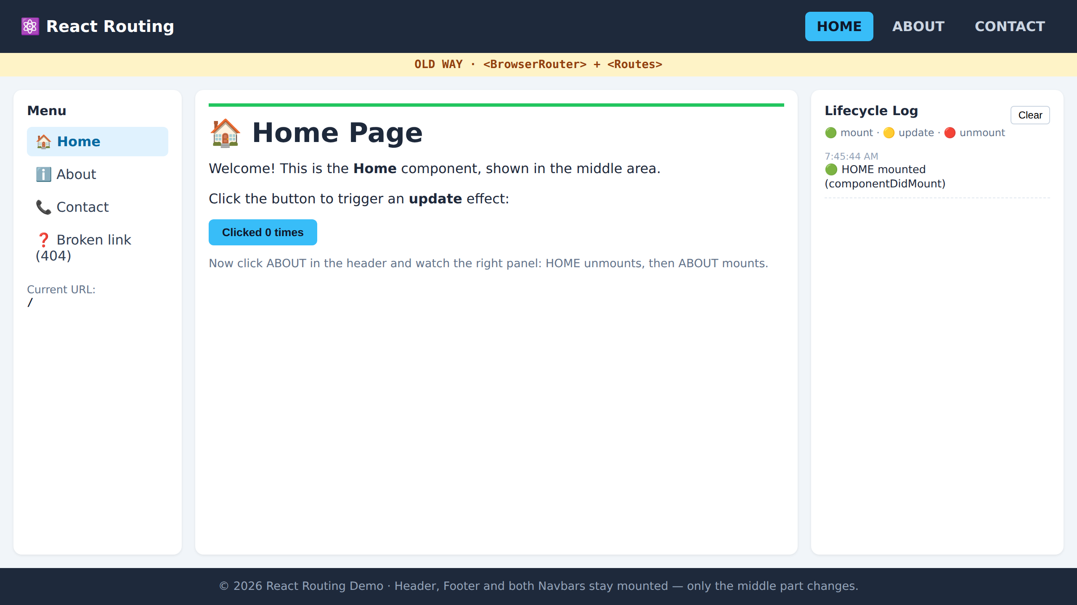
React Routing
localhost:5173/
Old Way vs New Way
+ component lifecycle with useEffect
react-router-dom v6 · Vite · React 18
Notes:
Today: two ways to set up routing in React Router v6, and how useEffect shows a component being born, updated and destroyed as we move between pages.

Slide 2
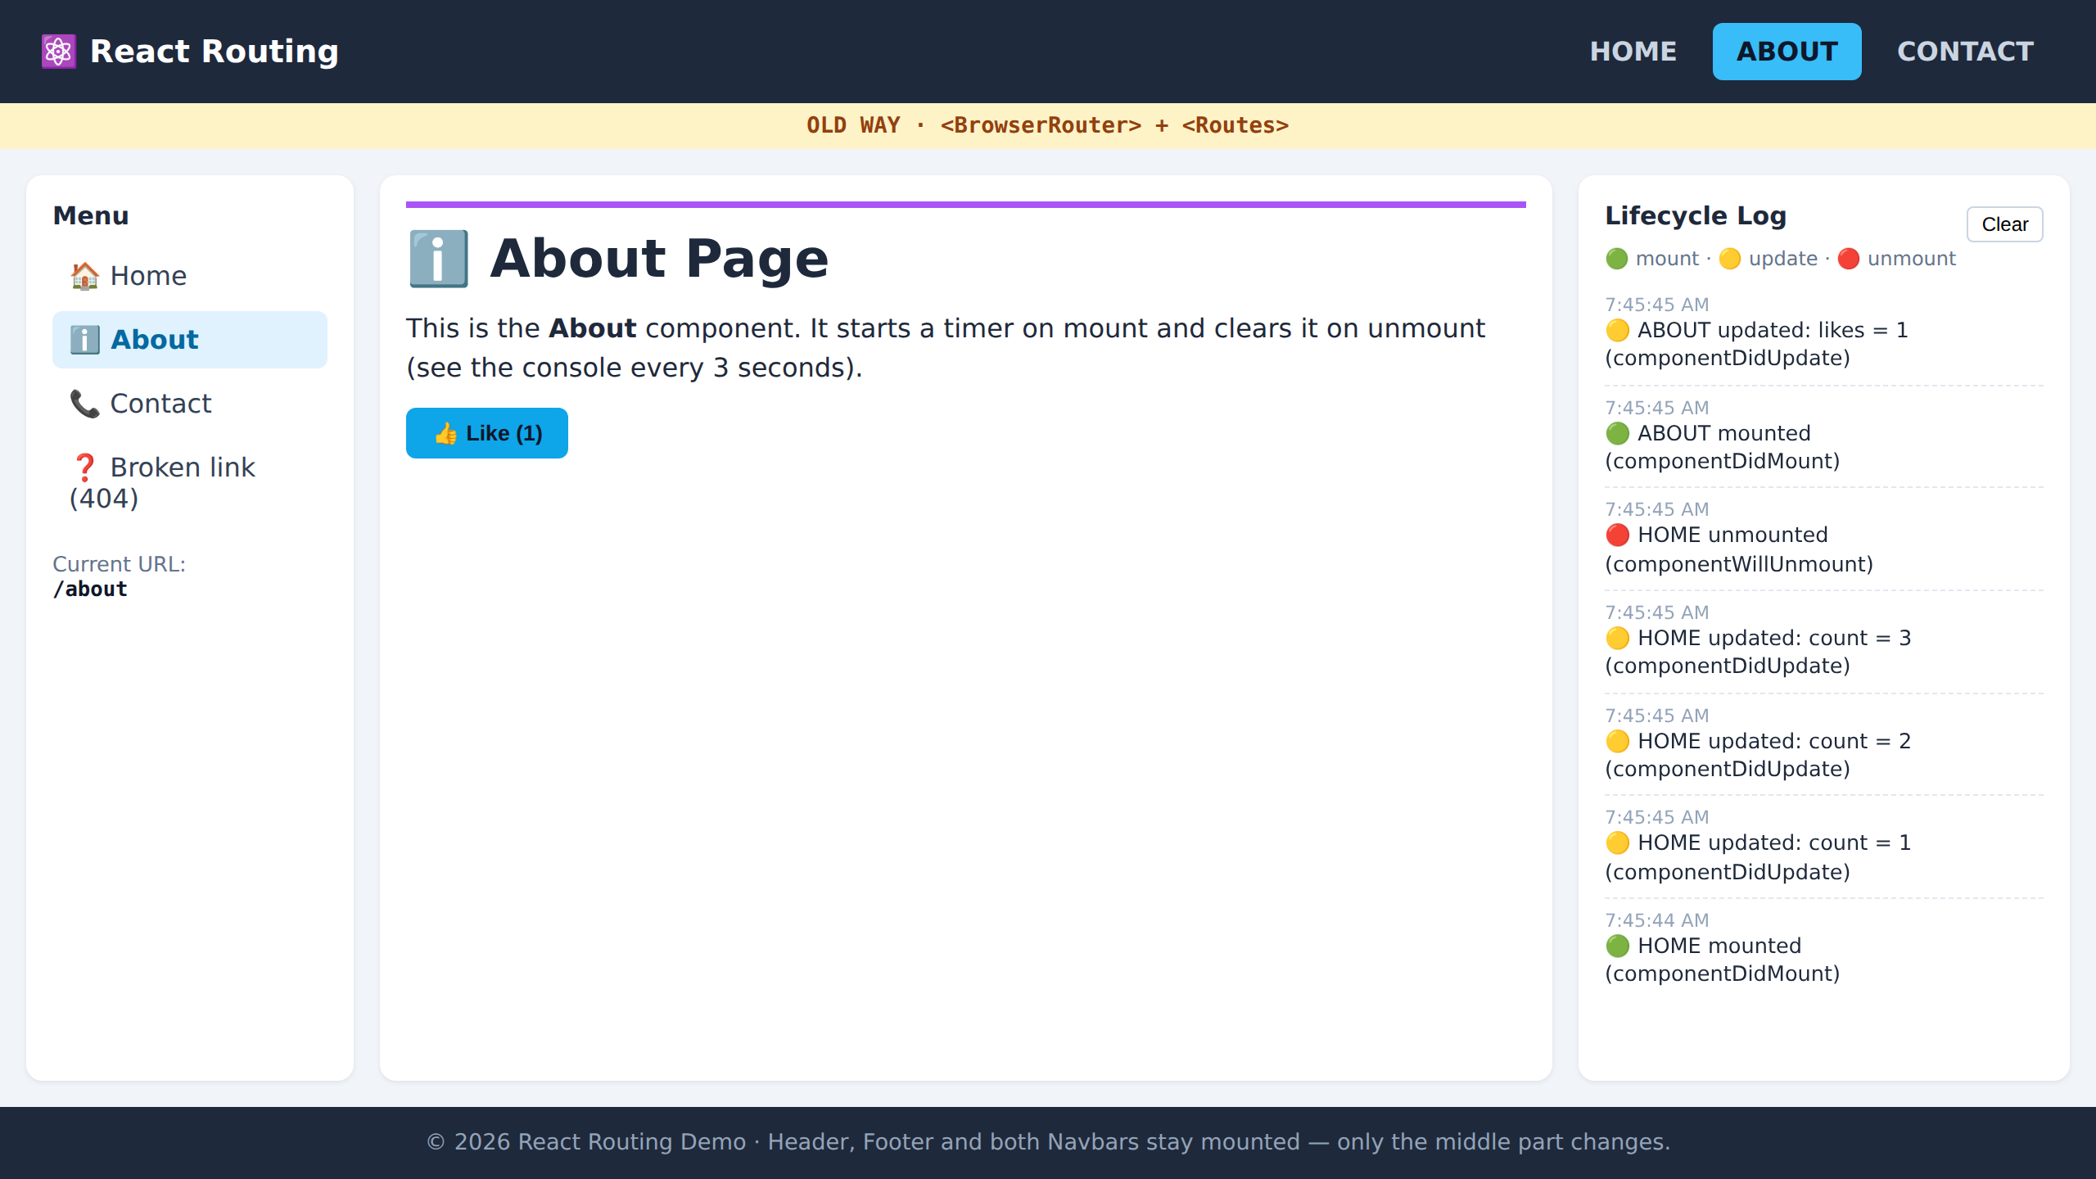
What we are building
One page frame. Only the middle part changes when you click a link.
Header (HOME · ABOUT · CONTACT)
localhost:5173/about
Left
Navbar
<Outlet />
Home | About | Contact
Right
Navbar
(log)
Footer
Stays mounted: Header, Footer, both Navbars. Swapped by the router: the cyan box.
Notes:
The layout: header with HOME, ABOUT, CONTACT; left navbar; right navbar which shows lifecycle logs; footer. The middle is an <Outlet /> — a placeholder the router fills with the page that matches the URL.

Slide 3
Project setup
Create a Vite app and add React Router
terminal
folder structure
npm create vite@latest my-app
(choose: React → JavaScript)
cd my-app
npm install react-router-dom
npm run dev
src/
├── main.jsx // pick OLD or NEW here
├── lifecycleLog.js // log helper
├── old-way/AppOld.jsx
├── new-way/AppNew.jsx
├── components/
│ ├── Layout.jsx
│ ├── Header.jsx Footer.jsx
│ └── LeftNavbar.jsx RightNavbar.jsx
└── pages/
├── Home.jsx About.jsx
└── Contact.jsx NotFound.jsx
Open http://localhost:5173 and press F12 to see the console.
Notes:
Only one extra package: react-router-dom. Walk through the folders: pages are what appear in the middle, components are the frame, old-way and new-way are the two routing styles.

Slide 4
Layout.jsx — the common frame
Used by both routing styles
src/components/Layout.jsx
<Outlet />
import { Outlet } from "react-router-dom";
import Header from "./Header";
import Footer from "./Footer";
import LeftNavbar from "./LeftNavbar";
import RightNavbar from "./RightNavbar";
function Layout({ badge }) {
return (
<div className="layout">
<Header />
<div className="body">
<LeftNavbar />
<main className="content">
<Outlet /> {/* page goes here */}
</main>
<RightNavbar />
</div>
<Footer />
</div>
);
}
A placeholder for the child route
URL / → Home
URL /about → About
URL /contact → Contact
Everything around it never re-mounts
Notes:
Outlet is the key idea of nested routing. The parent route renders Layout, and whichever child route matches the URL is rendered where Outlet sits.

Slide 5
Header.jsx — links without page reload
<NavLink> instead of <a href>
src/components/Header.jsx
<a href> reloads the whole page — state is lost
<Link> changes URL, no reload
<NavLink> = Link + adds class "active" to the current page
end so "/" is not active on /about
import { NavLink } from "react-router-dom";
function Header() {
return (
<header className="header">
<div className="logo">React Routing</div>
<nav>
<NavLink to="/" end>HOME</NavLink>
<NavLink to="/about">ABOUT</NavLink>
<NavLink to="/contact">CONTACT</NavLink>
</nav>
</header>
);
}
Notes:
Output below: ABOUT is highlighted cyan because NavLink added the active class. Without 'end', HOME would also be active on every page because every URL starts with '/'.

Slide 6
01
The Old Way
<BrowserRouter> + <Routes> + <Route>
Notes:
The declarative / component style. Routes are JSX tags inside the component tree. This is what most tutorials and existing projects use.

Slide 7
AppOld.jsx — routes written as JSX
OLD WAY
src/old-way/AppOld.jsx
<BrowserRouter>
import { BrowserRouter, Routes, Route } from "react-router-dom";
import Layout from "../components/Layout";
import Home from "../pages/Home";
import About from "../pages/About";
import Contact from "../pages/Contact";
import NotFound from "../pages/NotFound";
function AppOld() {
return (
<BrowserRouter>
<Routes>
<Route path="/" element={<Layout />}>
<Route index element={<Home />} />
<Route path="about" element={<About />} />
<Route path="contact" element={<Contact />} />
<Route path="*" element={<NotFound />} />
</Route>
</Routes>
</BrowserRouter>
);
}
export default AppOld;
turns on routing for the app
<Routes>
picks the ONE route that matches
<Route>
path → element to show
index
the default child ("/")
path="*"
catch-all → 404 page
Notes:
Nested Route: the parent path '/' renders Layout, children render inside Layout's Outlet. Child paths are relative — 'about' not '/about'.

Slide 8
Even older: React Router v5
You will still see this in old projects — it does NOT work in v6
v5 syntax
v6 syntax
// v5 (old projects)
<BrowserRouter>
<Header />
<Switch>
<Route exact path="/"
component={Home} />
<Route path="/about"
component={About} />
<Route path="/contact"
component={Contact} />
</Switch>
<Footer />
</BrowserRouter>
// v6 (what we use)
<BrowserRouter>
<Routes>
<Route path="/" element={<Layout />}>
<Route index
element={<Home />} />
<Route path="about"
element={<About />} />
<Route path="contact"
element={<Contact />} />
</Route>
</Routes>
</BrowserRouter>
Switch → Routes component={X} → element={<X />} exact → not needed
Notes:
Just so students recognise it. In v6 matching is exact by default, and Switch is gone.

Slide 9
Output — Old Way
OLD WAY
npm run dev → http://localhost:5173/
localhost:5173/
Yellow strip shows which style is running
URL "/" matched the index route → Home
HOME is active in header and menu
Right panel: 🟢 HOME mounted
Notes:
First load: Home mounts once, the log shows the mount effect.

Slide 10
02
The New Way
createBrowserRouter([...]) + <RouterProvider>
Notes:
The data-router style, recommended by the React Router team since v6.4. Routes are plain JavaScript objects created outside the component.

Slide 11
AppNew.jsx — routes as objects
NEW WAY
src/new-way/AppNew.jsx
createBrowserRouter
import { createBrowserRouter, RouterProvider } from "react-router-dom";
import Layout from "../components/Layout";
import Home from "../pages/Home";
import About from "../pages/About";
import Contact from "../pages/Contact";
import NotFound from "../pages/NotFound";
const router = createBrowserRouter([
{
path: "/",
element: <Layout />,
errorElement: <NotFound />,
children: [
{ index: true, element: <Home /> },
{ path: "about", element: <About /> },
{ path: "contact", element: <Contact /> },
{ path: "*", element: <NotFound /> },
],
},
]);
function AppNew() {
return <RouterProvider router={router} />;
}
builds the router from objects
children: [ ]
same as nested <Route>
index: true
default child ("/")
errorElement
shown if a route crashes
<RouterProvider>
plugs the router into React
Notes:
Same route tree as the old way, just written as data. The router is created once, outside the component, so it isn't rebuilt on every render.

Slide 12
main.jsx — switch between the two
Comment one line, uncomment the other, save
src/main.jsx
import AppOld →
import ReactDOM from "react-dom/client";
import "./index.css";
import App from "./old-way/AppOld"; // OLD WAY
// import App from "./new-way/AppNew"; // NEW WAY
ReactDOM.createRoot(document.getElementById("root"))
.render(<App />);
import AppNew →
Same header, same pages. The yellow strip tells students which App is running.
Why no <React.StrictMode>?
In development StrictMode mounts → unmounts → mounts every component twice. Great for finding bugs, confusing for a lifecycle demo.
Notes:
Try adding StrictMode back later and show the double mount log — a good discussion point.

Slide 13
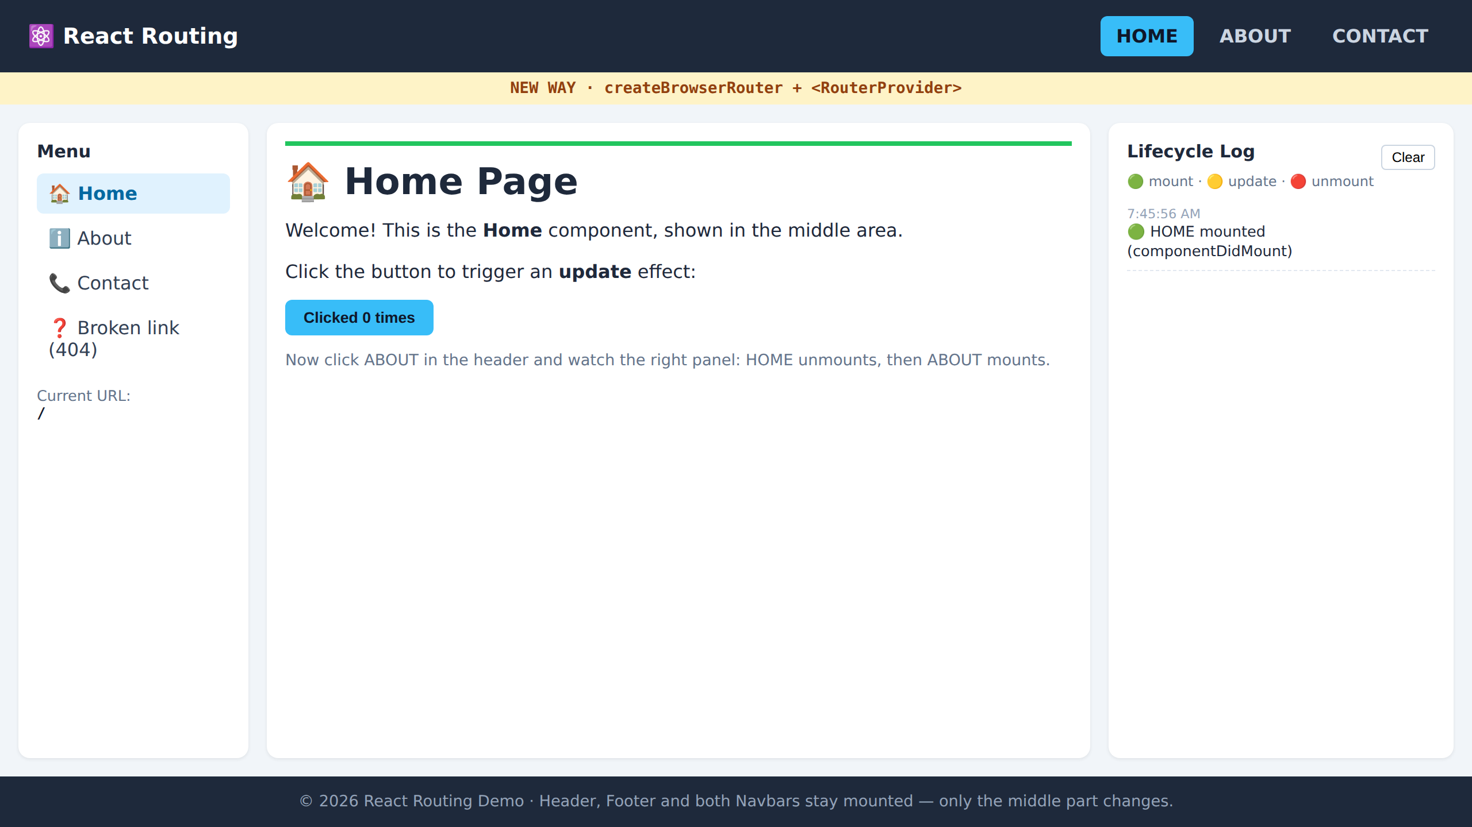
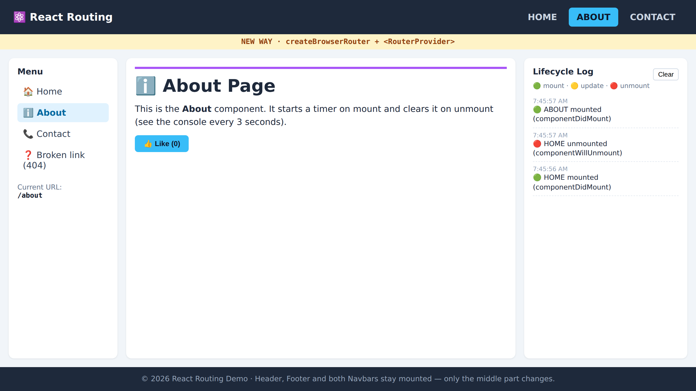
Output — New Way
NEW WAY
Same screen, different routing code underneath
localhost:5173/
localhost:5173/about
① Load /
② Click ABOUT
🟢 HOME mounted
🔴 HOME unmounted → 🟢 ABOUT mounted
Notes:
Point out: the user sees no difference. The difference is in how routes are defined and the extra features you unlock.

Slide 14
Old Way vs New Way
 | Old Way | New Way
Setup | <BrowserRouter> | createBrowserRouter([...])
Routes written as | JSX <Route> tags | JavaScript objects
Where | inside a component | outside, at file level
Rendered by | <Routes> | <RouterProvider router={router} />
Nested routes | <Route> inside <Route> | children: [ ... ]
Default child | <Route index /> | { index: true }
Extra features | — | loader, action, errorElement
Both use the same Layout, <Outlet />, <NavLink>, useLocation() — only the route definition changes.
Notes:
Recommendation: learn the old way to read existing code, use the new way for new projects.

Slide 15
03
Component Lifecycle
useEffect → mount · update · unmount
Notes:
Now the second goal: watch each page component being created, updated and destroyed as we route between them.

Slide 16
useEffect = lifecycle methods
What the dependency array means
🟢 Mount
🟡 Update
🔴 Unmount
componentDidMount
componentDidUpdate
componentWillUnmount
useEffect(() => {
...
}, []);
useEffect(() => {
...
}, [count]);
useEffect(() => {
return () => {...};
}, []);
Runs once, when the page appears
Runs when count changes
Cleanup runs when page leaves
No array at all → runs after EVERY render
Notes:
Class component names in grey for students who know classes. [] = once; [x] = whenever x changes; returned function = cleanup.

Slide 17
Home.jsx — mount, update, unmount
src/pages/Home.jsx
logLifecycle() writes to the console and to the right navbar, so students see it without DevTools.
import { useEffect, useState } from "react";
import { logLifecycle } from "../lifecycleLog";
function Home() {
const [count, setCount] = useState(0);
// MOUNT + UNMOUNT
useEffect(() => {
logLifecycle("🟢 HOME mounted");
return () => {
logLifecycle("🔴 HOME unmounted");
};
}, []);
// UPDATE
useEffect(() => {
if (count > 0)
logLifecycle(`🟡 HOME updated: count = ${count}`);
}, [count]);
return (
<button onClick={() => setCount(count + 1)}>
Clicked {count} times
</button>
);
}
Try it
Click the button 3 times
Go to ABOUT, come back
count is 0 again — Home was destroyed and re-created
Notes:
Emphasise the last point: state lives inside the component. Unmount = state gone.

Slide 18
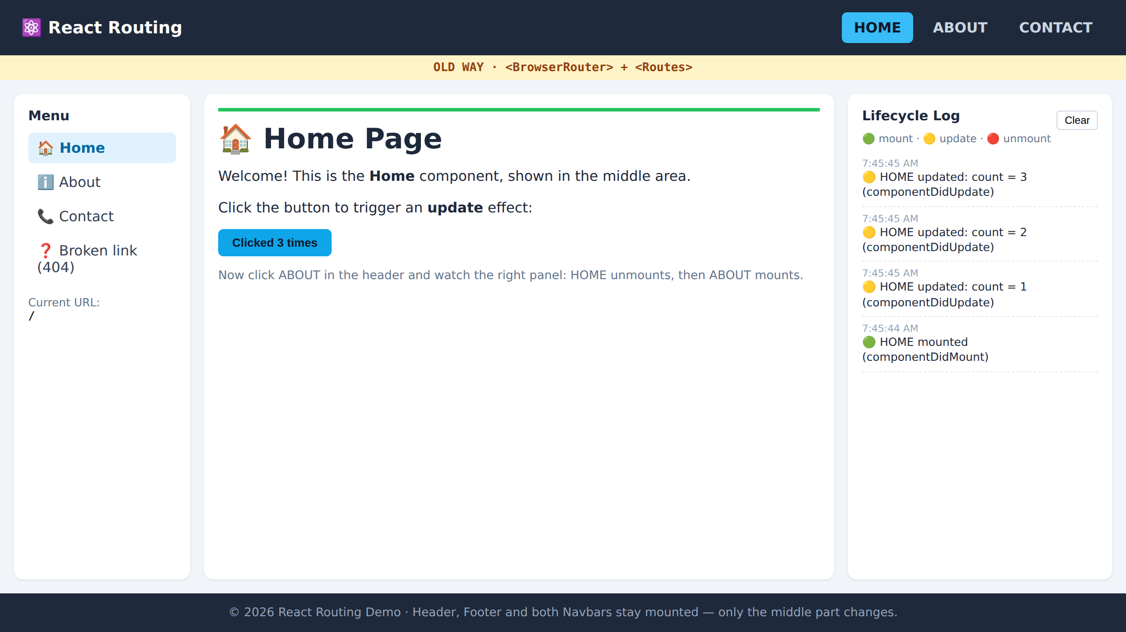
Output — Home after 3 clicks
localhost:5173/
Read the log bottom → top
🟢 HOME mounted
🟡 count = 1
🟡 count = 2
🟡 count = 3
Mount runs once. Update runs on every click.
Notes:
Newest log entry is on top.

Slide 19
About.jsx — why cleanup matters
A timer starts on mount and must be stopped on unmount
src/pages/About.jsx
Class experiment
function About() {
const [likes, setLikes] = useState(0);
useEffect(() => {
logLifecycle("🟢 ABOUT mounted");
const timer = setInterval(() => {
console.log("⏱️ ABOUT timer is still running...");
}, 3000);
return () => {
clearInterval(timer); // stop the timer!
logLifecycle("🔴 ABOUT unmounted – timer cleared");
};
}, []);
useEffect(() => {
if (likes > 0)
logLifecycle(`🟡 ABOUT updated: likes = ${likes}`);
}, [likes]);
return ( ... <button onClick={() => setLikes(likes + 1)}> ... );
}
Delete the clearInterval line
Open ABOUT, then go to HOME
Console keeps printing "timer is still running"
That is a memory leak
Notes:
The cleanup function is how React lets you undo side effects: timers, subscriptions, event listeners, sockets.

Slide 20
Output — navigating HOME → ABOUT
localhost:5173/about
browser console (F12)
[7:45:44] 🟢 HOME mounted
[7:45:45] 🟡 HOME updated: count = 1
[7:45:45] 🟡 HOME updated: count = 2
[7:45:45] 🟡 HOME updated: count = 3
[7:45:45] 🔴 HOME unmounted
[7:45:45] 🟢 ABOUT mounted
⏱️ ABOUT timer is still running...
[7:45:45] 🟡 ABOUT updated: likes = 1
Order matters
The old page unmounts first, then the new page mounts. Header, footer and navbars log nothing — they never left.
Notes:
This slide is the heart of the lesson: routing = unmounting one component and mounting another inside the same Outlet.

Slide 21
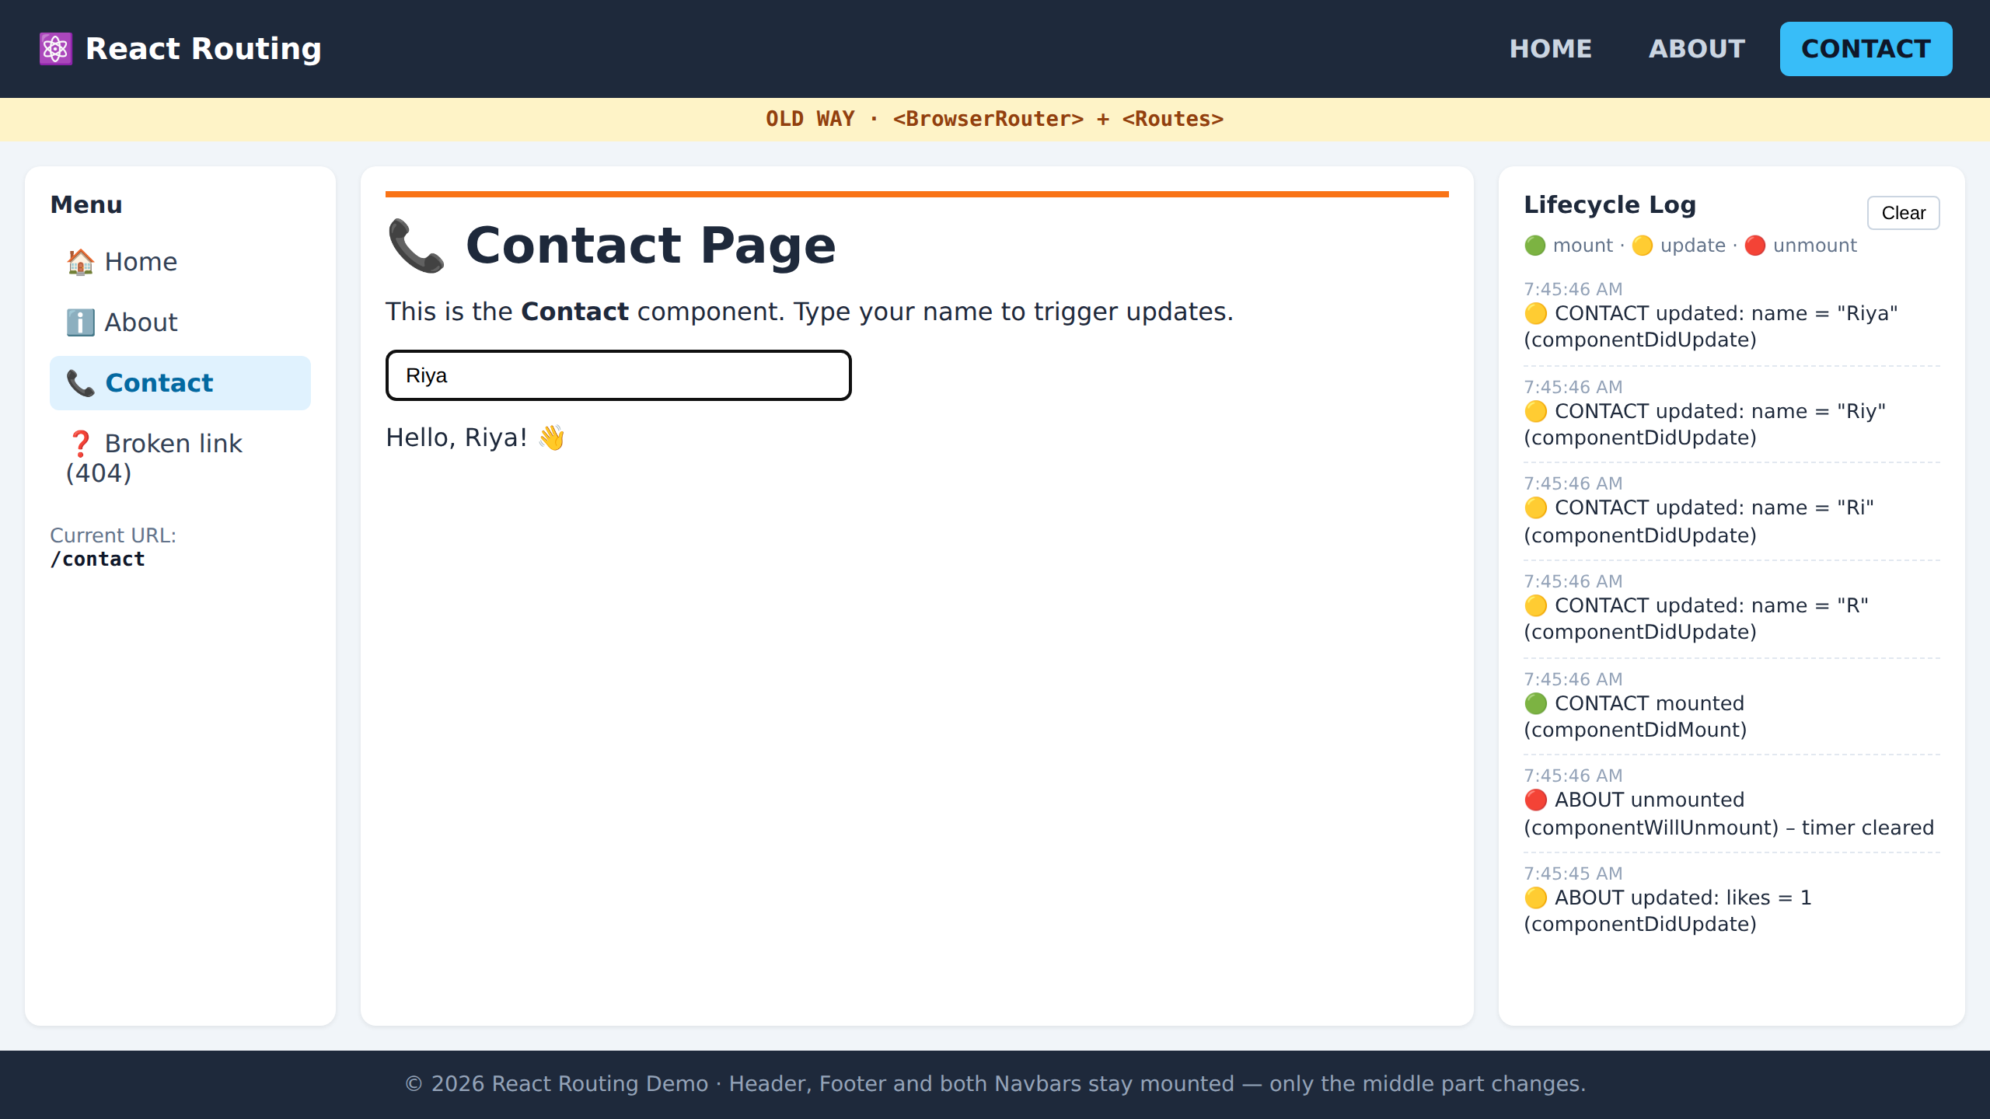
Contact.jsx — update on every key press
src/pages/Contact.jsx
localhost:5173/contact
function Contact() {
const [name, setName] = useState("");
useEffect(() => {
logLifecycle("🟢 CONTACT mounted");
return () =>
logLifecycle("🔴 CONTACT unmounted");
}, []);
useEffect(() => {
if (name !== "")
logLifecycle(`🟡 CONTACT updated: name = "${name}"`);
}, [name]);
return (
<section className="page page-contact">
<h1>Contact Page</h1>
<input value={name}
onChange={(e) => setName(e.target.value)} />
{name && <p>Hello, {name}!</p>}
</section>
);
}
Typing "Riya" = 4 key presses = 4 🟡 update logs (R, Ri, Riy, Riya).
The effect runs because name is in the dependency array.
Notes:
Ask: what happens if we change [name] to []? (Update logs disappear.) What if we remove the array? (Logs on every render.)

Slide 22
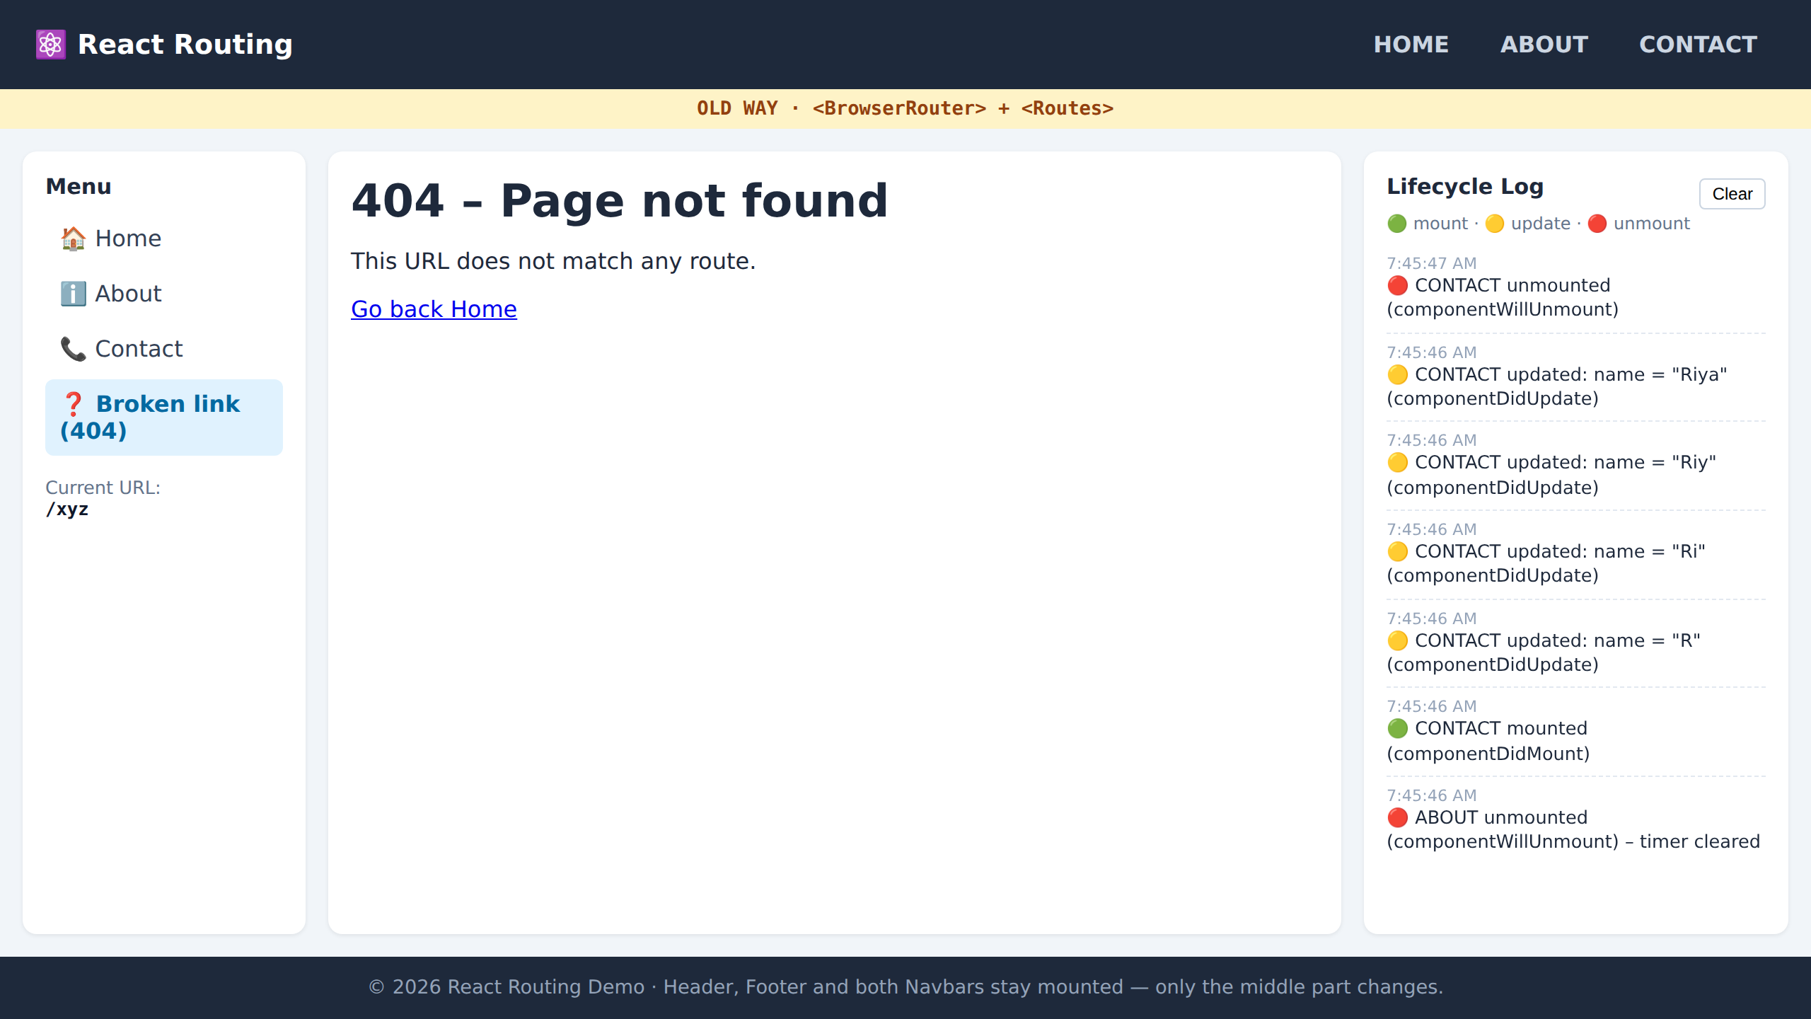
404 page and useLocation()
Catch-all route path="*"
NotFound.jsx · LeftNavbar.jsx
localhost:5173/xyz
// pages/NotFound.jsx
function NotFound() {
return (
<section className="page">
<h1>404 – Page not found</h1>
<Link to="/">Go back Home</Link>
</section>
);
}
// components/LeftNavbar.jsx
const location = useLocation();
<code>{location.pathname}</code>
URL /xyz matches no route → NotFound renders inside the same Layout. Left navbar shows the current URL via useLocation().
Old: <Route path="*" element={<NotFound />} />
New: { path: "*", element: <NotFound /> }
Notes:
useLocation is a hook that gives the current URL — handy for breadcrumbs, analytics, highlighting.

Slide 23
Recap
1
Old Way
<BrowserRouter> + <Routes> + <Route> — routes as JSX
2
New Way
createBrowserRouter([...]) + <RouterProvider> — routes as objects
3
Layout
<Outlet /> is where the matched page appears; the frame stays
4
Links
<NavLink> changes the URL without reloading and marks the active link
5
Lifecycle
[] = mount · [x] = update · return () => {} = unmount
Notes:
Homework idea: add a /services page in BOTH routing styles with its own useEffect logs.

